Slide 1
STOCK MARKET ANALYSIS
FADEKE ADENIYI, LUIS MALDONADO CHAVES, ANDREW MCLEAN, PREETI THOTTAMBETI
04/29/2021
Notes:
Preeti

Slide 2
PROJECT DESCRIPTION
We have three types clients that will like to invest $100,000 in the stock market
Their preference is influenced by their stock appetite
We will analyze the stock data from the past 5 years (2015-2020) and suggest portfolio composition options
Notes:
Preeti

Slide 3
USE CASE DESCRIPTION
Intuitively selected 30 Fortune 500 companies traded on the NYSE across different industry and with different risk profiles.
Three types of investors:
Low risk appetite
Medium risk appetite
High risk appetite
Create three portfolios using clustering analysis based on the investors’ risk appetites.
Make investment recommendations based on the returns, standard deviation, the Sharpe ratio and the efficient frontier using the Monte Carlo Simulation
Notes:
Preeti

Slide 4
USEFUL FEATURES/VARIABLES
Stock closing prices - stock prices at the end of the period
Daily returns - difference between a stock’s closing daily price and beginning daily price
Annual returns - stock price at the end of the year minus stock price at the beginning of the year, adjusted for dividend
Stock prices/returns correlation - mutual connection between the stock prices/returns
Standard deviation and variance - to measure the volatility and risk.
S&P 500 Prices - market benchmark
Sharpe ratio - use the alpha, beta and standard technical risk calculations to calculate and compare an investment’s returns, along with standard deviation and R-squared.
Alpha - excess return an investment or a portfolio of investments ushers in, above and beyond a market index or benchmark that represent the market’s broader movements.
Beta - measurement of the volatility, or systematic risk of a security or portfolio, compared to the market as a whole
Efficient frontier - use monte carlo simulation to calculate the efficient frontier by comparing the minimum variance portfolio and the sharpe ratio
Notes:
Luis

Slide 5
DATA SOURCE
We sourced the data from a python package ‘pandas_datareader’.
This package fetches stock data directly from yahoo finance.
Tickers = ['AAPL','MSFT','AMZN','TSLA','TGT','FB','V','WMT','PG','XOM','NSANY','ORCL','COST','CRM','NKE','JNJ','TMO','JPM', 'UNH','CI','INTC','CSCO','T','KO','DIS','UPS','NFLX','GM','HLT','PFE']
multpl_stocks = web.get_data_yahoo(tickers,start = "2015-01-01", end = "2020-12-31")
The data is open for public use
Notes:
Luis

Slide 6
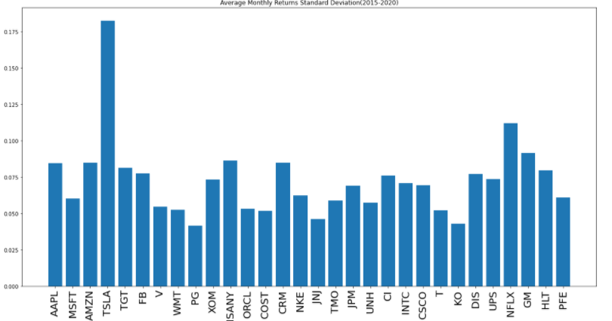
DATA VISUALIZATION - STANDARD DEVIATION
Notes:
Luis

Slide 7
CLUSTERING ANALYSIS
K-means clustering method used
Features: Daily and Monthly Variance
Widely accepted measures of stock volatility
Standardized feature vectors
Low, Medium, and High Risk clusters
Notes:
Andrew

Slide 8
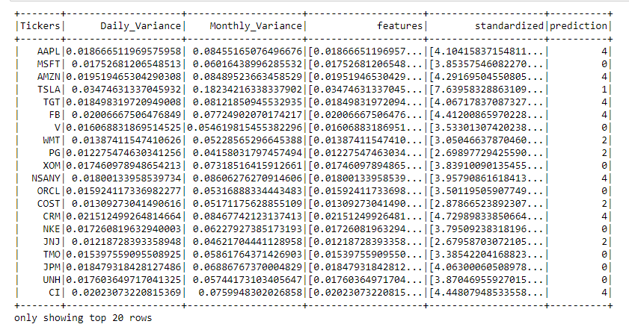
CLUSTERING ANALYSIS
Notes:
Andrew

Slide 9
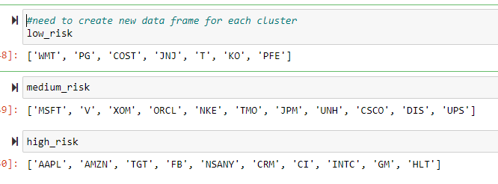
CLUSTERING ANALYSIS
Notes:
Andrew

Slide 10
MONTE CARLO SIMULATION
The Monte Carlo approach is a ‘brute force approach’.
With this approach, we try to discover the optimal weights by creating a large number of random portfolios (100,000)
Recording the Sharpe ratio of each of these randomly weighted portfolio
The random weightings will be bound by the constraint that they must be between zero and one for each of the individual stocks
All the weights must sum to one to represent an investment of 100% of the capital.
The more random portfolios that we create and calculate the Sharpe ratio for, the closer we get to the weightings of the “real” optimal portfolio.
The results will be plotted and both the “optimal” portfolio with the highest recorded Sharpe ratio and the “minimum variance portfolio” will be highlighted and marked for identification.
The “minimum variance portfolio” is the portfolio with the lowest recorded variance (standard deviation or volatility).
We repeated this process for the low risk clustered stocks, medium risk cluster and the high risk cluster.
Notes:
The Monte Carlo approach is a ‘brute force approach’. With this approach, we try to discover the optimal weights by simply creating a large number of random portfolios (100,000), all with varying combinations of constituent stock weightings, calculating and recording the Sharpe ratio of each of these randomly weighted portfolio and then finally extracting the details corresponding to the result with the highest value. The random weightings will be bound by the constraint that they must be between zero and one for each of the individual stocks, and all the weights must sum to one to represent an investment of 100% of the capital. The more random portfolios that we create and calculate the Sharpe ratio for, the closer we get to the weightings of the “real” optimal portfolio. We will always experience some discrepancies however as we can never run enough simulated portfolios to replicate the exact weights we are searching for. We can get close, but never exact. The results will be plotted and both the “optimal” portfolio with the highest recorded Sharpe ratio and the “minimum variance portfolio” will be highlighted and marked for identification. The “minimum variance portfolio” is the portfolio with the lowest recorded variance (which also, by definition displays the lowest recorded standard deviation or “volatility”). The values recorded are as previously mentioned, the annualized return, annualized standard deviation and annualized Sharpe ratio.
We repeated this process for the low risk clustered stocks, medium risk cluster and the high risk cluster.

Slide 11
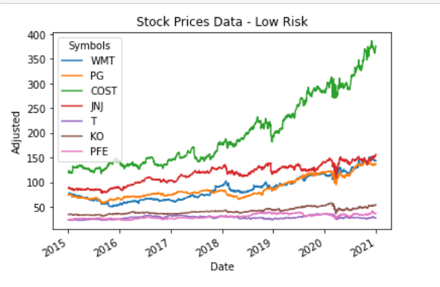
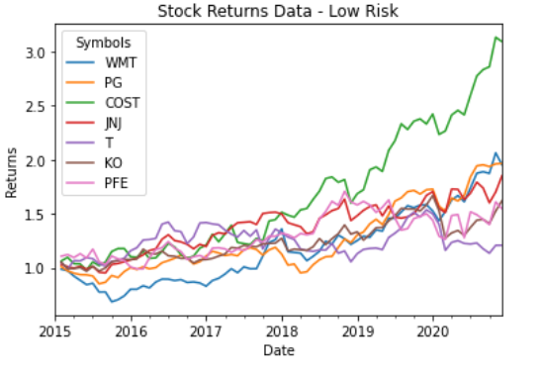
MONTE CARLO SIMULATION - LOW RISK
Notes:
Low Risk - Walmart, Procter & Gamble, Costco, Johnson & Johnson, AT&T, Coke, Pfizer
Collective Comparison of Stock prices:
The line graph plots the stock prices for all the stocks in the low risk cluster for the 5 years. Costco has the highest rise in prices from 2015 to 2021, followed by JNJ, Walmart, P&G, coke, AT&T and lastly Pfizer. Prices for the last 3 remained relatively stable.
Comparison of Stock Returns
The line graph plots the stock returns for all the stocks for the 5 years. Costco has the highest increase in returns, with a huge spike in 2018/2019.

Slide 12
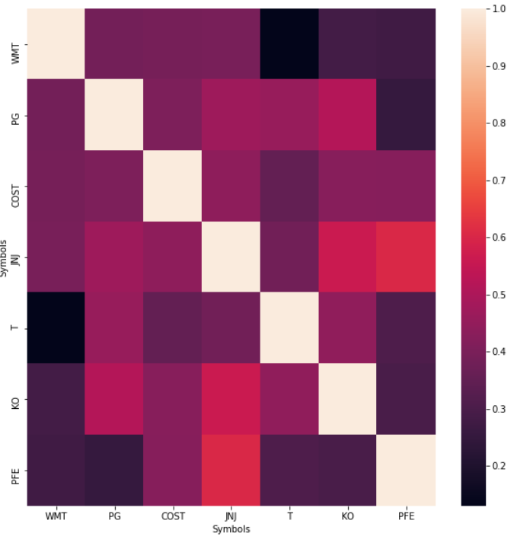
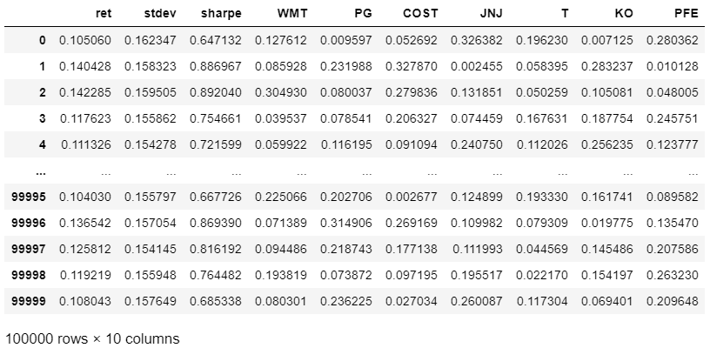
MONTE CARLO SIMULATION - LOW RISK
Notes:
Heatmap Showing Correlation
The heatmap below shows the correlation between the average returns of each stock. All the returns are positively correlated to one another.
We try to discover the optimal weights by simply creating a large number of random portfolios (100,000), all with varying combinations of constituent stock weightings, calculating and recording the Sharpe ratio of each of these randomly weighted portfolio and then finally extracting the details corresponding to the result with the highest value
Low Risk - Walmart, Procter & Gamble, Costco, Johnson & Johnson, AT&T, Coke, Pfizer

Slide 13
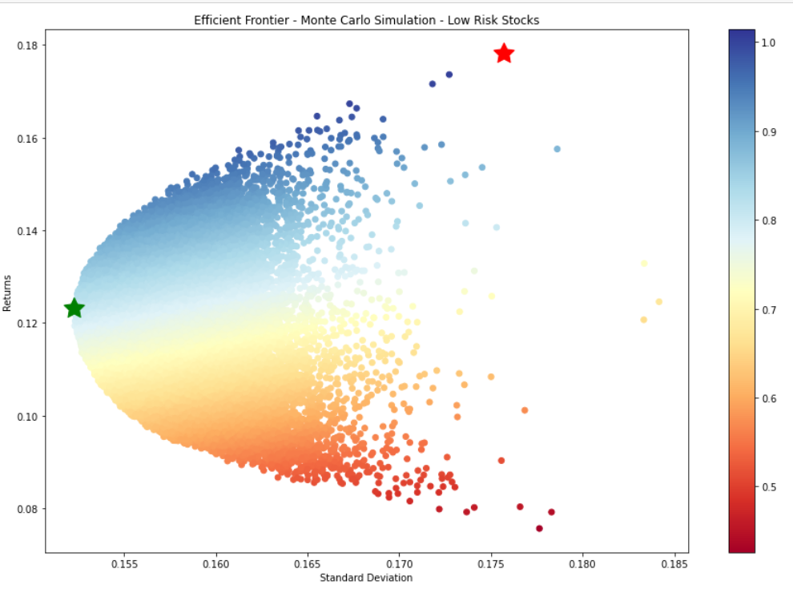
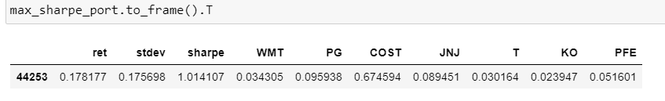
MONTE CARLO SIMULATION - LOW RISK
Notes:
After running the codes in python, below is the scatter plot for the efficient frontier. The data points are colored according to their respective Sharpe ratios, with blue signifying a higher value, and red a lower value.
Interpreting the efficient frontier, below is a table showing the stock weighting based on the Sharpe ratio and then for the minimum variance portfolio respectively:
Low Risk - Walmart, Procter & Gamble, Costco, Johnson & Johnson, AT&T, Coke, Pfizer
Low Risk - Walmart 3.4%, Procter & Gamble 9.6%, Costco 67.5%, Johnson & Johnson 8.9%, AT&T 3%, Coke 2.4%, Pfizer 5.2% = 100%

Slide 14
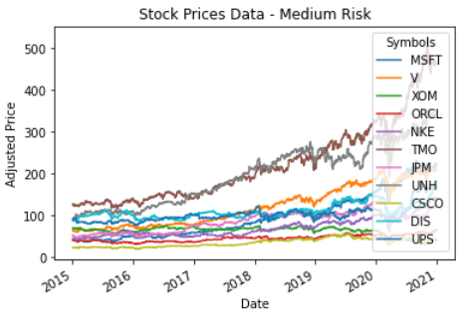
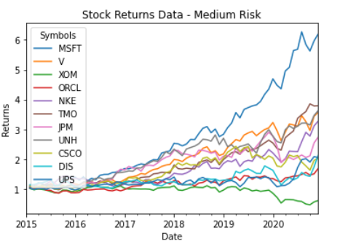
MONTE CARLO SIMULATION - MEDIUM RISK
Notes:
Medium Risk - Microsoft, Visa, Exxon, Oracle, Nike, Thermo Fisher Scientific, JPMorgan, United health, Cisco, Walt Disney, UPS
Collective Comparison of Stock prices:
The line graph plots the stock prices for all the stocks in the medium risk cluster for the 5 years. Thermo Fisher Scientific & United Health has the highest rise in prices from 2015 to 2021,
Comparison of Stock Returns
The line graph plots the stock returns for all the stocks n the medium risk cluster for the 5 years. Microsoft has the highest increase in returns.

Slide 15
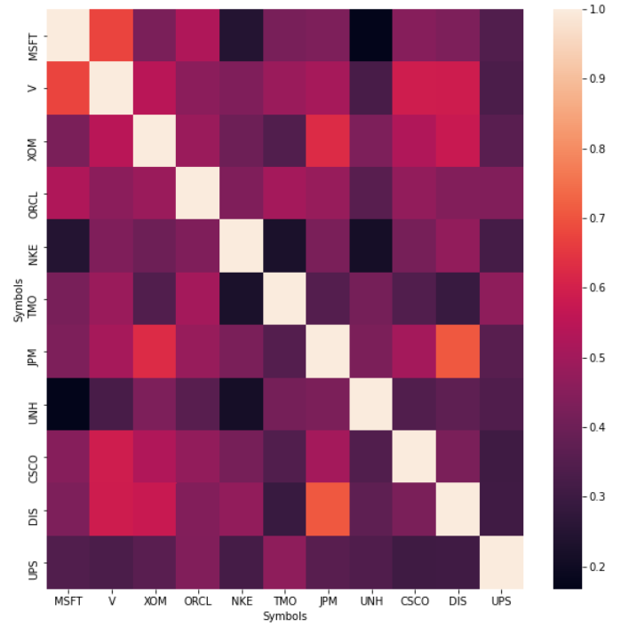
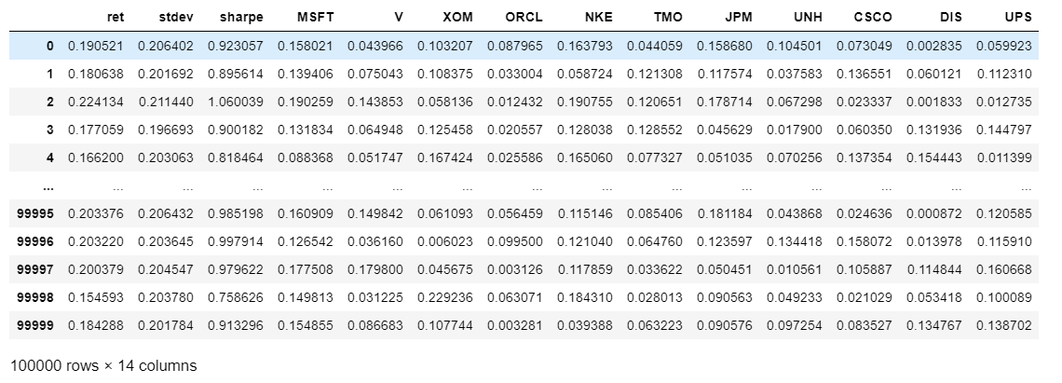
MONTE CARLO SIMULATION - MEDIUM RISK
Notes:
Medium Risk - Microsoft, Visa, Exxon, Oracle, Nike, Thermo Fisher Scientific, JPMorgan, United health, Cisco, Walt Disney, UPS
Heatmap Showing Correlation
The heatmap below shows the correlation between the average returns of each stock. All the returns are positively correlated to one another.
We try to discover the optimal weights by simply creating a large number of random portfolios (100,000), all with varying combinations of constituent stock weightings, calculating and recording the Sharpe ratio of each of these randomly weighted portfolio and then finally extracting the details corresponding to the result with the highest value

Slide 16
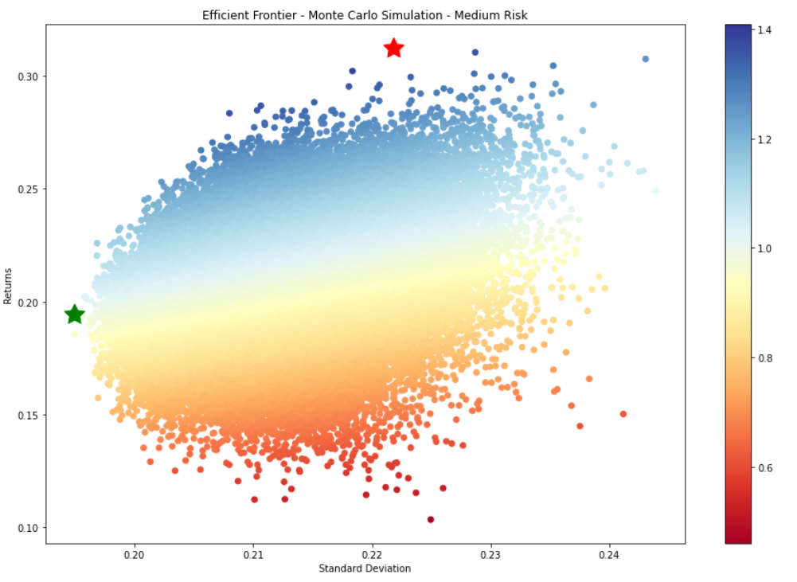
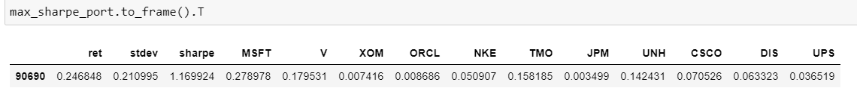
MONTE CARLO SIMULATION - MEDIUM RISK
Notes:
Medium Risk - Microsoft, Visa, Exxon, Oracle, Nike, Thermo Fisher Scientific, JPMorgan, United health, Cisco, Walt Disney, UPS
After running the codes in python, below is the scatter plot for the efficient frontier. The data points are colored according to their respective Sharpe ratios, with blue signifying a higher value, and red a lower value.
Interpreting the efficient frontier, below is a table showing the stock weighting based on the Sharpe ratio and then for the minimum variance portfolio respectively:
Medium Risk - Microsoft 27.9%, Visa 18%, Exxon 0.74%, Oracle 0.87%, Nike 5.1%, Thermo Fisher Scientific 15.8%, JPMorgan 0.35%, United health 14.2%, Cisco 7.1%, Walt Disney 6.3%, UPS 3.7% = 100%

Slide 17
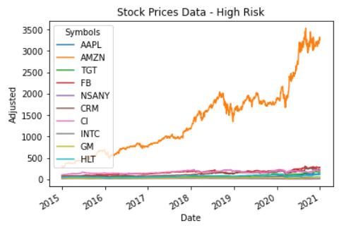
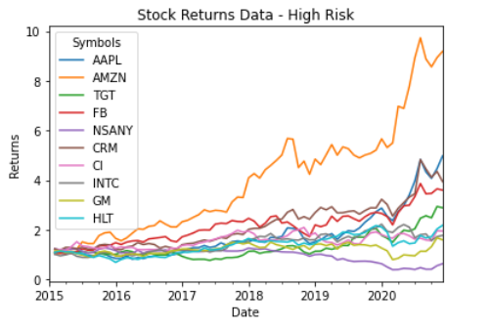
MONTE CARLO SIMULATION - HIGH RISK
Notes:
High Risk - Apple, Amazon, Target, FaceBook, Nissan motors, Salesforce, Cigna, Intel, General motors, Hilton
Collective Comparison of Stock prices:
The line graph plots the stock prices for all the stocks in the High risk cluster for the 5 years. Amazon has the highest rise in prices from 2015 to 2021,
Comparison of Stock Returns
The line graph plots the stock returns for all the stocks in the high risk cluster for the 5 years. Amazon has the highest increase in returns.

Slide 18
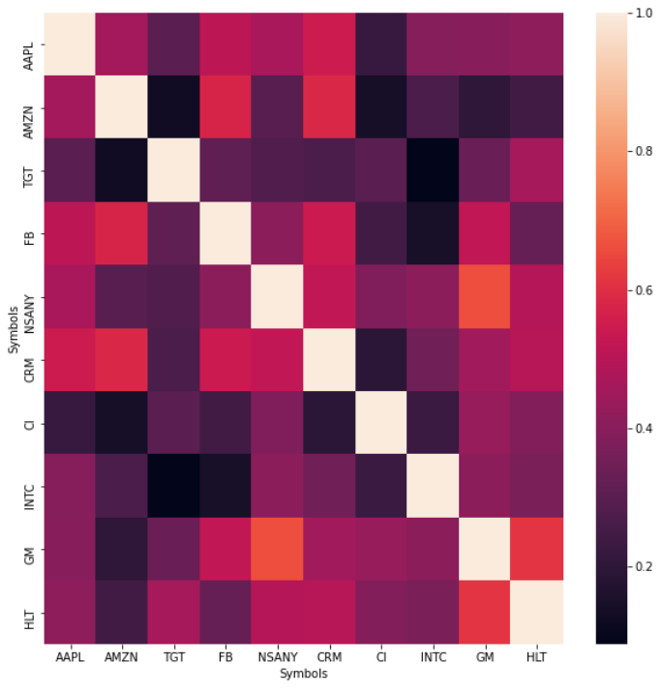
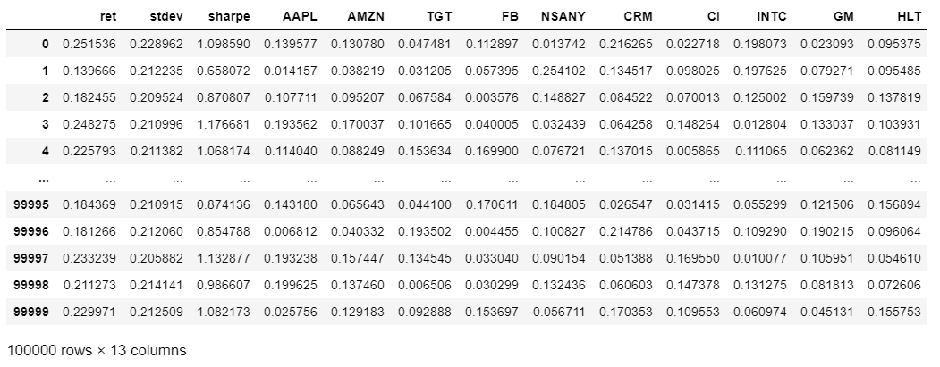
MONTE CARLO SIMULATION - HIGH RISK
Notes:
High Risk - Apple, Amazon, Target, FaceBook, Nissan motors, Salesforce, Cigna, Intel, General motors, Hilton
Heatmap Showing Correlation
The heatmap below shows the correlation between the average returns of each stock. All the returns are positively correlated to one another.
We try to discover the optimal weights by simply creating a large number of random portfolios (100,000), all with varying combinations of constituent stock weightings, calculating and recording the Sharpe ratio of each of these randomly weighted portfolio and then finally extracting the details corresponding to the result with the highest value

Slide 19
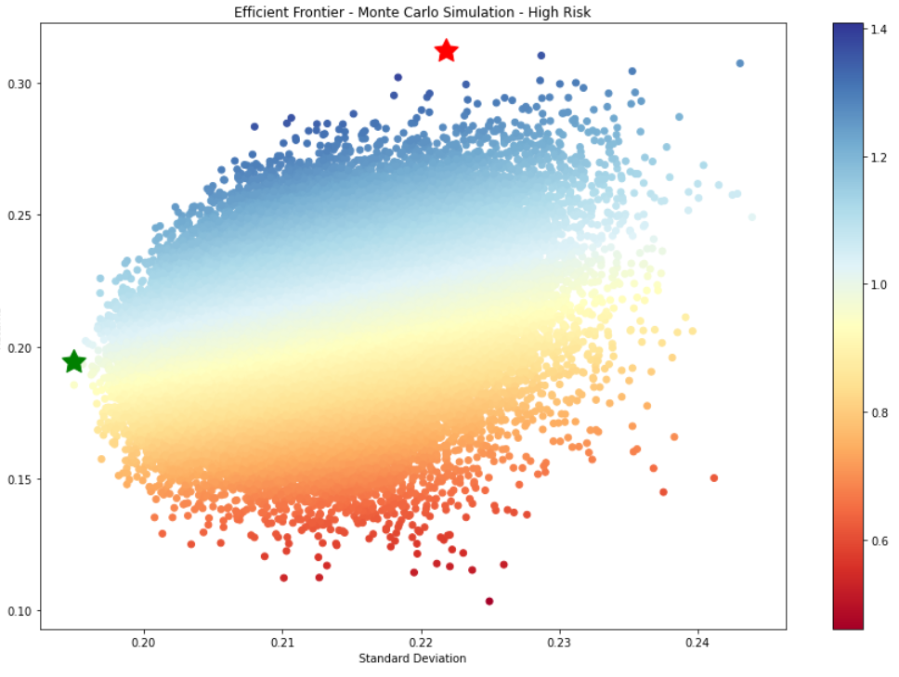
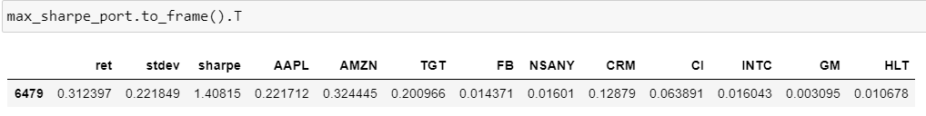
MONTE CARLO SIMULATION - HIGH RISK
Notes:
High Risk - Apple, Amazon, Target, FaceBook, Nissan motors, Salesforce, Cigna, Intel, General motors, Hilton
After running the codes in python, below is the scatter plot for the efficient frontier. The data points are colored according to their respective Sharpe ratios, with blue signifying a higher value, and red a lower value.
Interpreting the efficient frontier, below is a table showing the stock weighting based on the Sharpe ratio and then for the minimum variance portfolio respectively:
High Risk - Apple 22.17%, Amazon 32.4%, Target 20%, FaceBook 1.4%, Nissan motors 1.6%, Salesforce 12.88%, Cigna 6.4%, Intel 1.6%, General motors 0.31%, Hilton 1.1% = 100%

Slide 20
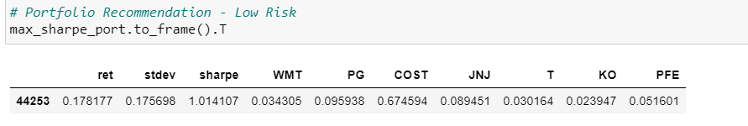
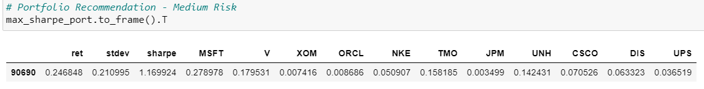
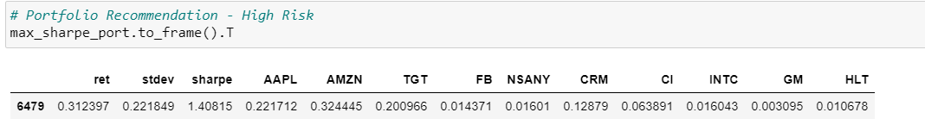
SUMMARIZED RECOMMENDATION
Notes:
Low Risk - Walmart 3.4%, Procter & Gamble 9.6%, Costco 67.5%, Johnson & Johnson 8.9%, AT&T 3%, Coke 2.4%, Pfizer 5.2% = 100%
Medium Risk - Microsoft 27.9%, Visa 18%, Exxon 0.74%, Oracle 0.87%, Nike 5.1%, Thermo Fisher Scientific 15.8%, JPMorgan 0.35%, United health 14.2%, Cisco 7.1%, Walt Disney 6.3%, UPS 3.7% = 100%
High Risk - Apple 22.17%, Amazon 32.4%, Target 20%, FaceBook 1.4%, Nissan motors 1.6%, Salesforce 12.88%, Cigna 6.4%, Intel 1.6%, General motors 0.31%, Hilton 1.1% = 100%

Slide 21
CONCLUSION
We used clustering analysis to categorize a total of 30 stocks into 5 clusters.
K-Means cluster algorithm is a very efficient way to create clusters through the numerous iterations. Variance was the key indicator to determining the volatility of various stocks and classifying each company into their corresponding cluster.
We then used the Monte Carlo Simulation to determine the optimal portfolio for our investors by comparing the Shape Ratio, value at risk and returns. This plotted the Efficient frontier from which the most efficient portfolio was chosen.
The recommendation system that we have developed will help our clients make the best investment decision based on their tolerable risk appetite.
Notes:
Luis

Slide 22
Q&A

